Slide 1
OptumCare CDO Infrastructure Cloud-Readiness Inventory Analysis
Data Captured 11/26/19-3/6/20
March 15, 2020

Slide 2


Technical Overview
CPU
STORAGE
PHYSICAL ALLOCATED
30.87 THz
204.11 TB (36% Used)
5.78 PB (54% Used)
VIRTUAL PROVISIONED
60.96 THz
115.53 TB (43% Used)
4.57 PB (47% Used)
AVG UTILIZATION
4.8%
35%
51%
HEADROOM
55%
34%
49%
13 CDOs Inventoried
~1,100 Physical
Servers
Data Collected Between 11/26/19 and 03/06/20
~6,500 Virtual Servers
~21,500 SQL Databases
Notes:
Difference between Physical Allocation and Virtual Provisioning:
Possible over-provisioning of resources in the hypervisor could account for 2/1 ratio in CPU allocation
Missing Movere data for physical resources causing under-reporting
Utilization is the average amount of used resources compared against the total (i.e. Used/Total)
Headroom is the measurement that Movere uses to calculate how close the workload is to the next Azure Profile

Slide 3
Movere Analysis
Numbers included are directly from the Movere portal extracts and have been minimally cleaned/normalized for analysis. Analysis was performed using both Excel and Tableau
This analysis represents a portion of each CDO’s environment. Some servers may have been excluded due to existing/ongoing incidents and/or concerns over performance degradation, and these exclusions will skew certain numbers (e.g. Physical CPU and RAM Provisioned)
More internal analysis needs to be conducted to validate Movere data

Slide 4
Movere Analysis – What’s not included
Network utilization costs need to be factored into financials – upfront cost for ExpressRoute + utilization ingress/egress
10 Gbps circuit (US Central) = $3,400/month
Inbound data = unlimited
Outbound data = nothing included
Different rate per zone [i.e. .025/GB up to .14/GB (replication becomes expensive)]
Roll-up financial analysis based on Microsoft VM sizing estimates

Slide 5
Financials

Slide 6
Adjusted Financial Estimate by CDO Virtual Servers – ARC Sized
CDO | Server Count | Movere Estimated Rate per Hour | Optum Adjusted Rate per Hour* | Cost per Month | Optum Adjusted Cost per Month** | 3 Year Total | Optum Adjusted 3 Year Total***
DMG | 1658 | $477.91 | $610.71 | $348,874.30 | $445,814.73 | $12,559,474.80 | $16,049,330.37
MOUNTAIN WEST | 1293 | $392.20 | $501.42 | $286,306.00 | $366,040.15 | $10,307,016.00 | $13,177,445.40
WellMed | 522 | $141.51 | $181.80 | $103,302.30 | $132,710.43 | $3,718,882.80 | $4,777,575.57
RELIANT | 515 | $93.85 | $121.03 | $68,510.50 | $88,350.89 | $2,466,378.00 | $3,180,631.95
SCA | 458 | $77.96 | $100.77 | $56,910.80 | $73,561.27 | $2,048,788.80 | $2,648,205.72
MONARCH | 460 | $146.96 | $188.74 | $107,280.80 | $137,783.02 | $3,862,108.80 | $4,960,188.72
POLYCLINIC | 340 | $81.02 | $104.67 | $59,144.60 | $76,409.37 | $2,129,205.60 | $2,750,737.14
PHNY | 246 | $61.50 | $79.78 | $44,895.00 | $58,241.13 | $1,616,220.00 | $2,096,680.50
PHCT | 231 | $74.83 | $96.78 | $54,625.90 | $70,648.02 | $1,966,532.40 | $2,543,328.81
NAMM | 169 | $43.40 | $56.70 | $31,682.00 | $41,394.55 | $1,140,552.00 | $1,490,203.80
APPLECARE | 85 | $17.41 | $23.57 | $12,709.30 | $17,204.36 | $457,534.80 | $619,356.87
USMD | 81 | $22.55 | $30.12 | $16,461.50 | $21,988.41 | $592,614.00 | $791,582.85
Total | 6058 | $1,631.10 | $2,096.09 | $1,190,703.00 | $1,530,146.33 | $42,865,308.00 | $55,085,267.70
*Rate per Hour = ((Movere estimate * 85% Optum rate) + 50% margin on actual CSP usage) + ($1,000 HCC Monthly fee / 730 hours / month) * 150% margin (EXCEL FORMULA: =SUM((([Movere Rate per Hour]*0.85) * 1.5) + ($1,000/730))
(Actual CSP usage based on Movere estimate but monthly usage will most likely be variable)
**Cost per Month = Rate per Hour * 730 Hours/month (average hours per month)
***3 Year Total = Cost per Month * 36
Amounts calculated in Movere based on Azure ready VMs and ARC (Actual Resource Consumption) data collected and default Azure pricing
Notes:
As presented in Movere, no contract

Slide 7
Adjusted Financial Estimate by CDO Physical Servers – ARC Sized
CDO | Server Count | Movere Estimated Rate per Hour | Optum Adjusted Rate per Hour* | Cost per Month | Optum Adjusted Cost per Month** | 3 Year Total | Optum Adjusted 3 Year Total***
DMG | 153 | $400.31 | $511.77 | $292,226.30 | $373,588.53 | $10,520,146.80 | $13,449,187.17
MOUNTAIN WEST | 56 | $49.83 | $64.90 | $36,375.90 | $47,379.27 | $1,309,532.40 | $1,705,653.81
WellMed | 72 | $121.63 | $156.45 | $88,789.90 | $114,207.12 | $3,196,436.40 | $4,111,456.41
RELIANT | 36 | $10.25 | $14.44 | $7,482.50 | $10,540.19 | $269,370.00 | $379,446.75
SCA | 160 | $51.95 | $67.61 | $37,923.50 | $49,352.46 | $1,365,246.00 | $1,776,688.65
MONARCH | 0 | $0.00 | $1.37 | $0.00 | $1,000.00 | $0.00 | $36,000.00
POLYCLINIC | 3 | $0.68 | $2.24 | $496.40 | $1,632.91 | $17,870.40 | $58,784.76
PHNY | 46 | $53.45 | $69.52 | $39,018.50 | $50,748.59 | $1,404,666.00 | $1,826,949.15
PHCT | 9 | $16.28 | $22.13 | $11,884.40 | $16,152.61 | $427,838.40 | $581,493.96
NAMM | 0 | $0.00 | $1.37 | $0.00 | $1,000.00 | $0.00 | $36,000.00
APPLECARE | 2 | $1.72 | $3.56 | $1,255.60 | $2,600.89 | $45,201.60 | $93,632.04
USMD | 0 | $0.00 | $1.37 | $0.00 | $1,000.00 | $0.00 | $36,000.00
Total | 537 | $706.10 | $916.72 | $515,453.00 | $669,202.58 | $18,556,308.00 | $24,091,292.70
*Rate per Hour = ((Movere estimate * 85% Optum rate) + 50% margin on actual CSP usage) + ($1,000 HCC Monthly fee / 730 hours / month) * 150% margin (EXCEL FORMULA: =SUM((([Movere Rate per Hour]*0.85) * 1.5) + ($1,000/730))
(Actual CSP usage based on Movere estimate but monthly usage will most likely be variable)
**Cost per Month = Rate per Hour * 730 Hours/month (average hours per month)
***3 Year Total = Cost per Month * 36
Amounts calculated in Movere based on Azure ready VMs and ARC (Actual Resource Consumption) data collected and default Azure pricing
Notes:
As presented in Movere, no contract

Slide 8
Adjusted Financial Estimate by CDO All Servers – ARC Sized
CDO | Server Count | Movere Estimated Rate per Hour | Optum Adjusted Rate per Hour* | Cost per Month | Optum Adjusted Cost per Month** | 3 Year Total | Optum Adjusted 3 Year Total***
DMG | 1811 | $878.22 | $1,121.10 | $641,100.60 | $818,403.27 | $23,079,621.60 | $29,462,517.54
MOUNTAIN WEST | 1349 | $442.03 | $564.96 | $322,681.90 | $412,419.42 | $11,616,548.40 | $14,847,099.21
WellMed | 594 | $263.14 | $336.87 | $192,092.20 | $245,917.56 | $6,915,319.20 | $8,853,031.98
RELIANT | 551 | $104.10 | $134.10 | $75,993.00 | $97,891.08 | $2,735,748.00 | $3,524,078.70
SCA | 618 | $129.91 | $167.01 | $94,834.30 | $121,913.73 | $3,414,034.80 | $4,388,894.37
MONARCH | 460 | $146.96 | $188.74 | $107,280.80 | $137,783.02 | $3,862,108.80 | $4,960,188.72
POLYCLINIC | 343 | $81.70 | $105.54 | $59,641.00 | $77,042.28 | $2,147,076.00 | $2,773,521.90
PHNY | 292 | $114.95 | $147.93 | $83,913.50 | $107,989.71 | $3,020,886.00 | $3,887,629.65
PHCT | 240 | $91.11 | $117.54 | $66,510.30 | $85,800.63 | $2,394,370.80 | $3,088,822.77
NAMM | 169 | $43.40 | $56.70 | $31,682.00 | $41,394.55 | $1,140,552.00 | $1,490,203.80
APPLECARE | 87 | $19.13 | $25.76 | $13,964.90 | $18,805.25 | $502,736.40 | $676,988.91
USMD | 81 | $22.55 | $30.12 | $16,461.50 | $21,988.41 | $592,614.00 | $791,582.85
Total | 6595 | $2,337.20 | $2,996.37 | $1,706,156.00 | $2,187,348.90 | $61,421,616.00 | $78,744,560.40
*Rate per Hour = ((Movere estimate * 85% Optum rate) + 50% margin on actual CSP usage) + ($1,000 HCC Monthly fee / 730 hours / month) * 150% margin (EXCEL FORMULA: =SUM((([Movere Rate per Hour]*0.85) * 1.5) + ($1,000/730))
(Actual CSP usage based on Movere estimate but monthly usage will most likely be variable)
**Cost per Month = Rate per Hour * 730 Hours/month (average hours per month)
***3 Year Total = Cost per Month * 36
Amounts calculated in Movere based on Azure ready VMs and ARC (Actual Resource Consumption) data collected and default Azure pricing
Notes:
As presented in Movere, no contract

Slide 9
Adjusted Financial Estimate by CDO Virtual Servers – ALL
CDO | Server Count | Movere Estimated Rate per Hour | Optum Adjusted Rate per Hour* | Cost per Month | Optum Adjusted Cost per Month** | 3 Year Total | Optum Adjusted 3 Year Total***
DMG | 1756 | $521.27 | $665.99 | $380,527.10 | $486,172.05 | $13,698,975.60 | $17,502,193.89
MOUNTAIN WEST | 1324 | $411.09 | $525.51 | $300,095.70 | $383,622.02 | $10,803,445.20 | $13,810,392.63
WellMed | 651 | $191.09 | $245.01 | $139,495.70 | $178,857.02 | $5,021,845.20 | $6,438,852.63
RELIANT | 559 | $110.57 | $142.35 | $80,716.10 | $103,913.03 | $2,905,779.60 | $3,740,868.99
SCA | 482 | $89.94 | $116.04 | $65,656.20 | $84,711.66 | $2,363,623.20 | $3,049,619.58
MONARCH | 460 | $146.96 | $188.74 | $107,280.80 | $137,783.02 | $3,862,108.80 | $4,960,188.72
POLYCLINIC | 348 | $84.97 | $109.71 | $62,028.10 | $80,085.83 | $2,233,011.60 | $2,883,089.79
PHNY | 255 | $65.15 | $84.44 | $47,559.50 | $61,638.36 | $1,712,142.00 | $2,218,981.05
PHCT | 239 | $76.46 | $98.86 | $55,815.80 | $72,165.15 | $2,009,368.80 | $2,597,945.22
NAMM | 170 | $43.73 | $57.13 | $31,922.90 | $41,701.70 | $1,149,224.40 | $1,501,261.11
APPLECARE | 90 | $19.86 | $26.69 | $14,497.80 | $19,484.70 | $521,920.80 | $701,449.02
USMD | 81 | $22.55 | $30.12 | $16,461.50 | $21,988.41 | $592,614.00 | $791,582.85
Total | 6415 | $1,783.64 | $2,290.58 | $1,302,057.20 | $1,672,122.93 | $46,874,059.20 | $60,196,425.48
*Rate per Hour = ((Movere estimate * 85% Optum rate) + 50% margin on actual CSP usage) + ($1,000 HCC Monthly fee / 730 hours / month) * 150% margin (EXCEL FORMULA: =SUM((([Movere Rate per Hour]*0.85) * 1.5) + ($1,000/730))
(Actual CSP usage based on Movere estimate but monthly usage will most likely be variable)
**Cost per Month = Rate per Hour * 730 Hours/month (average hours per month)
***3 Year Total = Cost per Month * 36
Amounts calculated in Movere based on Azure ready VMs and ARC (Actual Resource Consumption) data collected and default Azure pricing
Notes:
As presented in Movere, no contract

Slide 10
Adjusted Financial Estimate by CDO Physical Servers – ALL
CDO | Server Count | Movere Estimated Rate per Hour | Optum Adjusted Rate per Hour* | Cost per Month | Optum Adjusted Cost per Month** | 3 Year Total | Optum Adjusted 3 Year Total***
DMG | 171 | $416.19 | $532.01 | $303,818.70 | $388,368.84 | $10,937,473.20 | $13,981,278.33
MOUNTAIN WEST | 68 | $100.62 | $129.66 | $73,452.60 | $94,652.07 | $2,644,293.60 | $3,407,474.34
WellMed | 110 | $853.82 | $1,089.99 | $623,288.60 | $795,692.97 | $22,438,389.60 | $28,644,946.74
RELIANT | 39 | $117.69 | $151.42 | $85,913.70 | $110,539.97 | $3,092,893.20 | $3,979,438.83
SCA | 168 | $55.35 | $71.94 | $40,405.50 | $52,517.01 | $1,454,598.00 | $1,890,612.45
MONARCH | 0 | $0.00 | $1.37 | $0.00 | $1,000.00 | $0.00 | $36,000.00
POLYCLINIC | 3 | $0.68 | $2.24 | $496.40 | $1,632.91 | $17,870.40 | $58,784.76
PHNY | 52 | $60.45 | $78.44 | $44,128.50 | $57,263.84 | $1,588,626.00 | $2,061,498.15
PHCT | 9 | $16.28 | $22.13 | $11,884.40 | $16,152.61 | $427,838.40 | $581,493.96
NAMM | 1 | $0.97 | $2.61 | $708.10 | $1,902.83 | $25,491.60 | $68,501.79
APPLECARE | 2 | $1.72 | $3.56 | $1,255.60 | $2,600.89 | $45,201.60 | $93,632.04
USMD | 1 | $5.21 | $8.01 | $3,803.30 | $5,849.21 | $136,918.80 | $210,571.47
Total | 624 | $1,628.98 | $2,093.39 | $1,189,155.40 | $1,528,173.14 | $42,809,594.40 | $55,014,232.86
*Rate per Hour = ((Movere estimate * 85% Optum rate) + 50% margin on actual CSP usage) + ($1,000 HCC Monthly fee / 730 hours / month) * 150% margin (EXCEL FORMULA: =SUM((([Movere Rate per Hour]*0.85) * 1.5) + ($1,000/730))
(Actual CSP usage based on Movere estimate but monthly usage will most likely be variable)
**Cost per Month = Rate per Hour * 730 Hours/month (average hours per month)
***3 Year Total = Cost per Month * 36
Amounts calculated in Movere based on Azure ready VMs and ARC (Actual Resource Consumption) data collected and default Azure pricing
Notes:
As presented in Movere, no contract

Slide 11
Adjusted Financial Estimate by CDO All Servers
CDO | Server Count | Movere Estimated Rate per Hour | Optum Adjusted Rate per Hour* | Cost per Month | Optum Adjusted Cost per Month** | 3 Year Total | Optum Adjusted 3 Year Total***
DMG | 1927 | $937.46 | $1,196.63 | $684,345.80 | $873,540.90 | $24,636,448.80 | $31,447,472.22
MOUNTAIN WEST | 1392 | $511.71 | $653.80 | $373,548.30 | $477,274.08 | $13,447,738.80 | $17,181,866.97
WellMed | 761 | $1,044.91 | $1,333.63 | $762,784.30 | $973,549.98 | $27,460,234.80 | $35,047,799.37
RELIANT | 598 | $228.26 | $292.40 | $166,629.80 | $213,453.00 | $5,998,672.80 | $7,684,307.82
SCA | 650 | $145.29 | $186.61 | $106,061.70 | $136,228.67 | $3,818,221.20 | $4,904,232.03
MONARCH | 460 | $146.96 | $188.74 | $107,280.80 | $137,783.02 | $3,862,108.80 | $4,960,188.72
POLYCLINIC | 351 | $85.65 | $110.57 | $62,524.50 | $80,718.74 | $2,250,882.00 | $2,905,874.55
PHNY | 307 | $125.60 | $161.51 | $91,688.00 | $117,902.20 | $3,300,768.00 | $4,244,479.20
PHCT | 248 | $92.74 | $119.61 | $67,700.20 | $87,317.76 | $2,437,207.20 | $3,143,439.18
NAMM | 171 | $44.70 | $58.36 | $32,631.00 | $42,604.53 | $1,174,716.00 | $1,533,762.90
APPLECARE | 92 | $21.58 | $28.88 | $15,753.40 | $21,085.59 | $567,122.40 | $759,081.06
USMD | 82 | $27.76 | $36.76 | $20,264.80 | $26,837.62 | $729,532.80 | $966,154.32
Total | 7039 | $3,412.62 | $4,367.53 | $2,491,212.60 | $3,188,296.07 | $89,683,653.60 | $114,778,658.34
*Rate per Hour = ((Movere estimate * 85% Optum rate) + 50% margin on actual CSP usage) + ($1,000 HCC Monthly fee / 730 hours / month) * 150% margin (EXCEL FORMULA: =SUM((([Movere Rate per Hour]*0.85) * 1.5) + ($1,000/730))
(Actual CSP usage based on Movere estimate but monthly usage will most likely be variable)
**Cost per Month = Rate per Hour * 730 Hours/month (average hours per month)
***3 Year Total = Cost per Month * 36
Amounts calculated in Movere based on Azure ready VMs and ARC (Actual Resource Consumption) data collected and default Azure pricing
Notes:
As presented in Movere, no contract

Slide 12
Movere Financial Estimate by CDO Contract Comparison – No Adjustment ARC Sized Servers
Platform (group) | CDO | Device Count | 3 Year Total (Pay As You Go - No Contract) | 3 Year Total (1yr All Up Front Reserved) | 3 Year Total (3yr All Up Front Reserved) | Upfront Cost
Physical | AppleCare | 2 | $25,071.12 | $20,101.84 | $17,188.70 | $17,188.70
 | DMG | 152 | $10,517,518.80 | $7,035,462.19 | $5,032,529.08 | $4,266,151.72
 | Mountain West | 56 | $1,363,926.74 | $1,115,156.31 | $982,722.46 | $706,624.78
 | PHCT | 9 | $427,759.56 | $315,022.83 | $243,658.96 | $231,438.76
 | PHNY | 46 | $1,404,705.42 | $917,003.02 | $658,641.71 | $630,600.95
 | PolyClinic | 3 | $14,270.04 | $12,617.82 | $11,833.88 | $3,949.88
 | Reliant | 36 | $275,572.08 | $225,134.72 | $194,826.52 | $146,497.60
 | SCA | 160 | $1,365,327.47 | $1,277,416.67 | $1,237,600.89 | $226,109.97
 | WellMed | 57 | $2,219,798.02 | $1,579,873.19 | $1,231,822.44 | $1,045,707.48
 | Total | 521 | $17,613,949.25 | $12,497,788.57 | $9,610,824.64 | $7,274,269.84
Virtual | AppleCare | 85 | $462,233.66 | $386,867.62 | $348,720.36 | $202,656.12
 | DMG | 1,658 | $12,662,844.55 | $10,454,794.75 | $9,278,160.85 | $5,710,992.49
 | Monarch | 465 | $3,878,594.24 | $3,307,714.31 | $3,001,502.96 | $1,693,889.00
 | Mountain West | 1,293 | $10,486,511.03 | $8,793,764.76 | $7,947,821.56 | $3,904,275.64
 | NAMM | 169 | $1,076,489.24 | $877,352.80 | $766,010.24 | $614,637.44
 | PHCT | 231 | $1,857,888.25 | $1,531,474.35 | $1,348,999.96 | $886,445.68
 | PHNY | 246 | $1,616,078.09 | $1,348,690.39 | $1,199,016.86 | $810,834.98
 | PolyClinic | 340 | $2,079,864.90 | $1,770,419.74 | $1,611,631.77 | $885,699.33
 | Reliant | 515 | $2,492,923.43 | $2,206,574.97 | $2,050,056.29 | $859,125.53
 | SCA | 458 | $2,045,377.66 | $1,777,439.66 | $1,643,885.23 | $754,412.35
 | USMD | 81 | $619,606.19 | $544,877.70 | $504,573.12 | $230,656.68
 | WellMed | 172 | $835,312.43 | $681,635.66 | $602,015.68 | $450,301.24
 | Other | 2 | $6,648.84 | $5,960.83 | $5,682.00 | $2,107.92
 | Total | 5,715 | $40,120,372.51 | $33,687,567.54 | $30,308,076.87 | $17,006,034.39
Grand Total |  | 6,236 | $57,734,321.76 | $46,185,356.11 | $39,918,901.51 | $24,280,304.23

Slide 13
Movere Financial Estimate by CDO Contract Comparison – No Adjustment ALL Servers
Platform (group) | CDO | Device Count Contract | 3 Year Total (Pay As You Go - No Contract) | 3 Year Total (1yr All Up Front Reserved) | 3 Year Total (3yr All Up Front Reserved) | Upfront Cost
Physical | AppleCare | 2 | $25,071.12 | $20,101.84 | $17,188.70 | $17,188.70
 | DMG | 171 | $10,937,307.64 | $7,392,342.48 | $5,339,647.94 | $4,573,270.58
 | Monarch
 | Mountain West | 68 | $2,698,609.10 | $2,279,344.81 | $1,991,266.61 | $1,715,168.93
 | NAMM | 1 | $25,544.16 | $18,941.05 | $15,801.11 | $15,801.11
 | PHCT | 9 | $427,759.56 | $315,022.83 | $243,658.96 | $231,438.76
 | PHNY | 52 | $1,588,612.86 | $1,075,726.07 | $795,841.18 | $767,800.42
 | PolyClinic | 3 | $14,270.04 | $12,617.82 | $11,833.88 | $3,949.88
 | Reliant | 39 | $3,099,147.84 | $1,896,073.62 | $1,246,085.38 | $1,197,756.46
 | SCA | 168 | $1,454,653.19 | $1,352,661.30 | $1,302,744.28 | $291,253.36
 | USMD | 1 | $136,892.52 | $119,404.23 | $103,440.45 | $103,440.45
 | WellMed | 110 | $22,626,086.62 | $14,682,044.44 | $10,304,570.90 | $9,308,637.74
 | Total | 624 | $43,033,954.64 | $29,164,280.48 | $21,372,079.38 | $18,225,706.38
Virtual | AppleCare | 90 | $526,567.10 | $439,823.66 | $393,739.31 | $247,675.07
 | DMG | 1,757 | $13,807,383.23 | $11,406,825.84 | $10,095,560.83 | $6,518,695.15
 | Monarch | 465 | $3,878,594.24 | $3,307,714.31 | $3,001,502.96 | $1,693,889.00
 | Mountain West | 1,324 | $10,982,827.22 | $9,215,471.24 | $8,312,296.00 | $4,268,750.08
 | NAMM | 170 | $1,085,056.52 | $884,816.32 | $772,474.86 | $621,102.06
 | PHCT | 239 | $1,900,724.65 | $1,568,791.95 | $1,381,325.42 | $918,771.14
 | PHNY | 255 | $1,711,894.97 | $1,423,625.97 | $1,261,765.87 | $873,583.99
 | PolyClinic | 348 | $2,183,618.34 | $1,858,039.10 | $1,685,839.13 | $959,906.69
 | Reliant | 559 | $2,932,403.87 | $2,588,325.09 | $2,380,569.07 | $1,189,638.31
 | SCA | 482 | $2,360,212.06 | $2,036,081.38 | $1,866,656.85 | $965,305.41
 | USMD | 81 | $619,606.19 | $544,877.70 | $504,573.12 | $230,656.68
 | WellMed | 651 | $5,079,027.85 | $4,140,643.67 | $3,610,326.94 | $3,035,951.26
 | Other | 66 | $1,282,379.90 | $916,213.04 | $672,268.16 | $665,724.44
 | Total | 6,487 | $48,350,296.15 | $40,331,249.27 | $35,938,898.52 | $22,189,649.28
Grand Total |  | 7,111 | $91,384,250.80 | $69,495,529.75 | $57,310,977.90 | $40,415,355.66

Slide 14
Charts and graphs

Slide 15
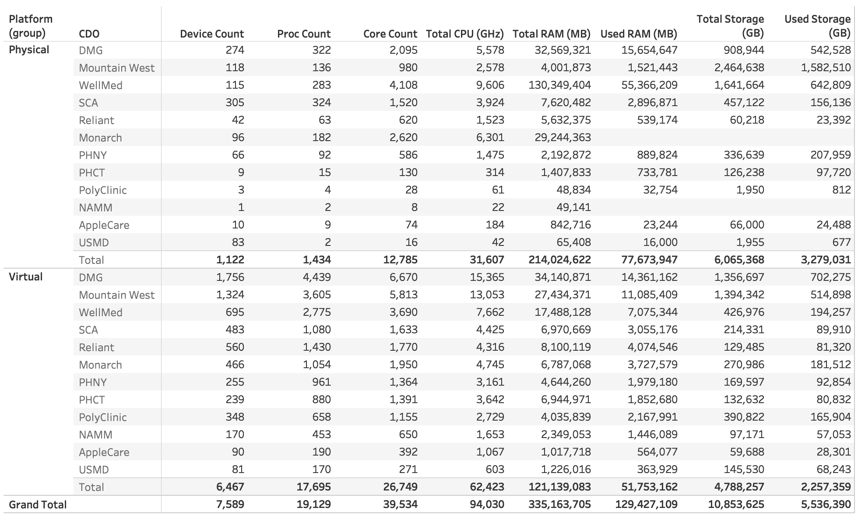
Infrastructure Totals by CDO

Slide 16
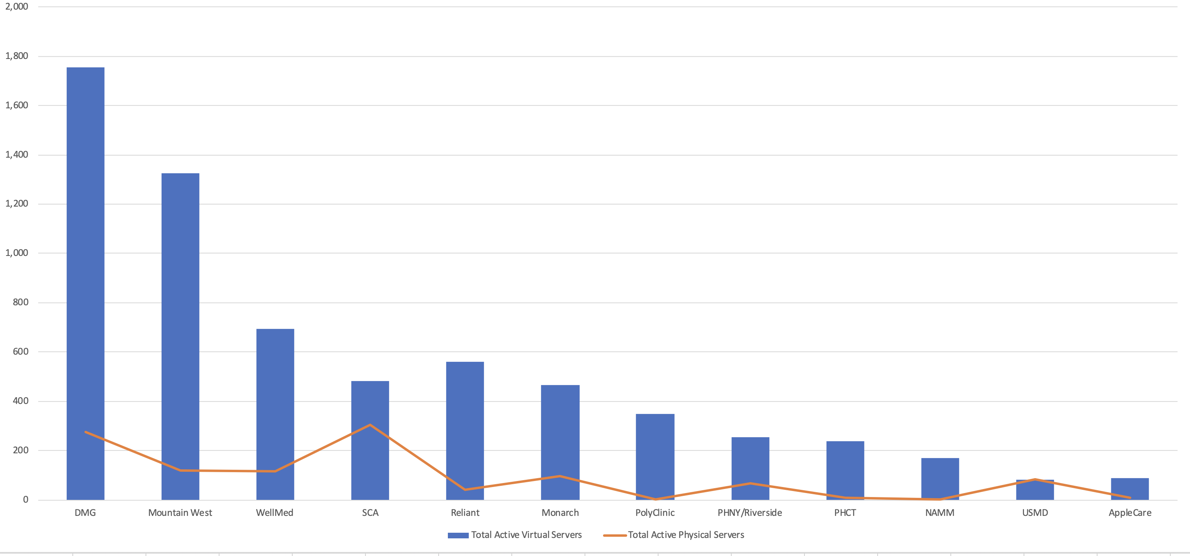
Total Server Inventory by CDO*
2,087
27%
1,493
19%
838
11%
604
797
8%
590
10%
8%
358
5%
327
260
4%
3%
178
2%
164
101
2%
1%
*Linux servers total < 1% and are not included
Notes:
White percentages represent CDO’s volume in relation to entire OptumCare landscape (i.e. “DMG accounts for 27% of the OptumCare infrastructure landscape.”)
Black numbers above blue columns indicate TOTAL number of servers (physical and virtual) in the CDO, for which we have Movere data
Only includes inventory captured by Movere. Excludes MedExpress, New West Physicians and AHN.

Slide 17
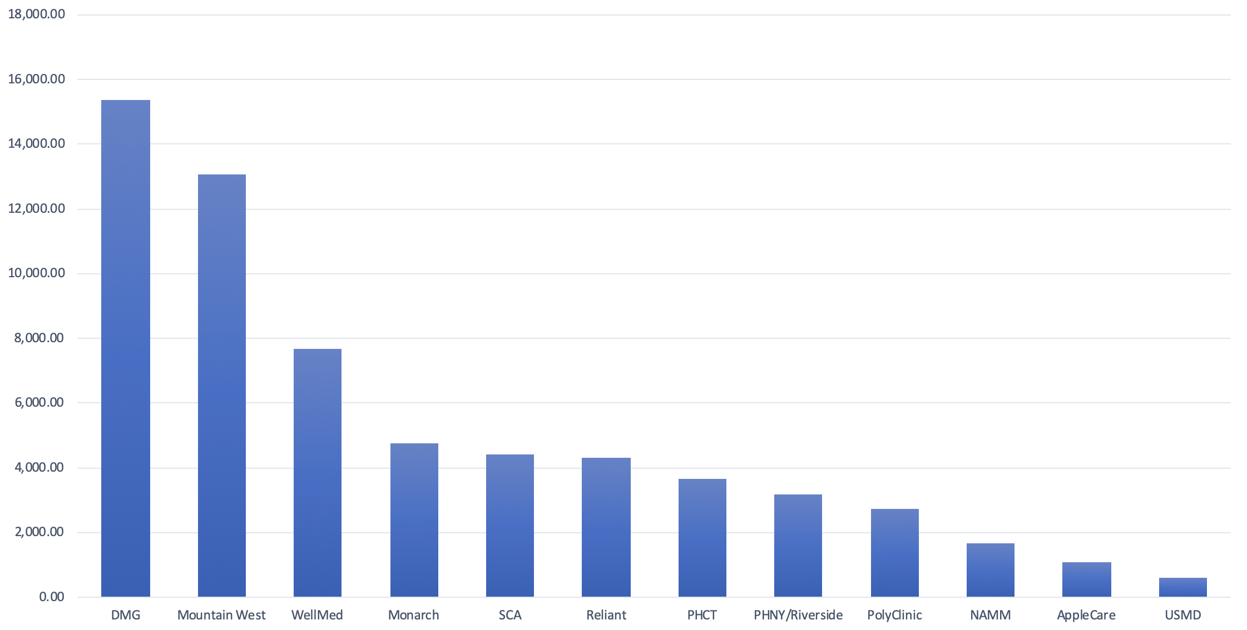
Virtual CPU Provisioned and Average Utilization by CDO
15 THz
4.5%
12.75 THz
4.7%
7.48 THz
4.9%
4.63 THz
4.32 THz
4.21THz
5.3%
4.4%
5.8%
3.56 THz
3.9%
3.09 THz
5%
2.67 THz
6.6%
1.61 THz
7.9%
1.04 THz
603 GHz
1.4%
6%
Notes:
Black numbers above blue columns represent total VIRTUAL CPU provisioned
White numbers indicate average CPU utilization

Slide 18
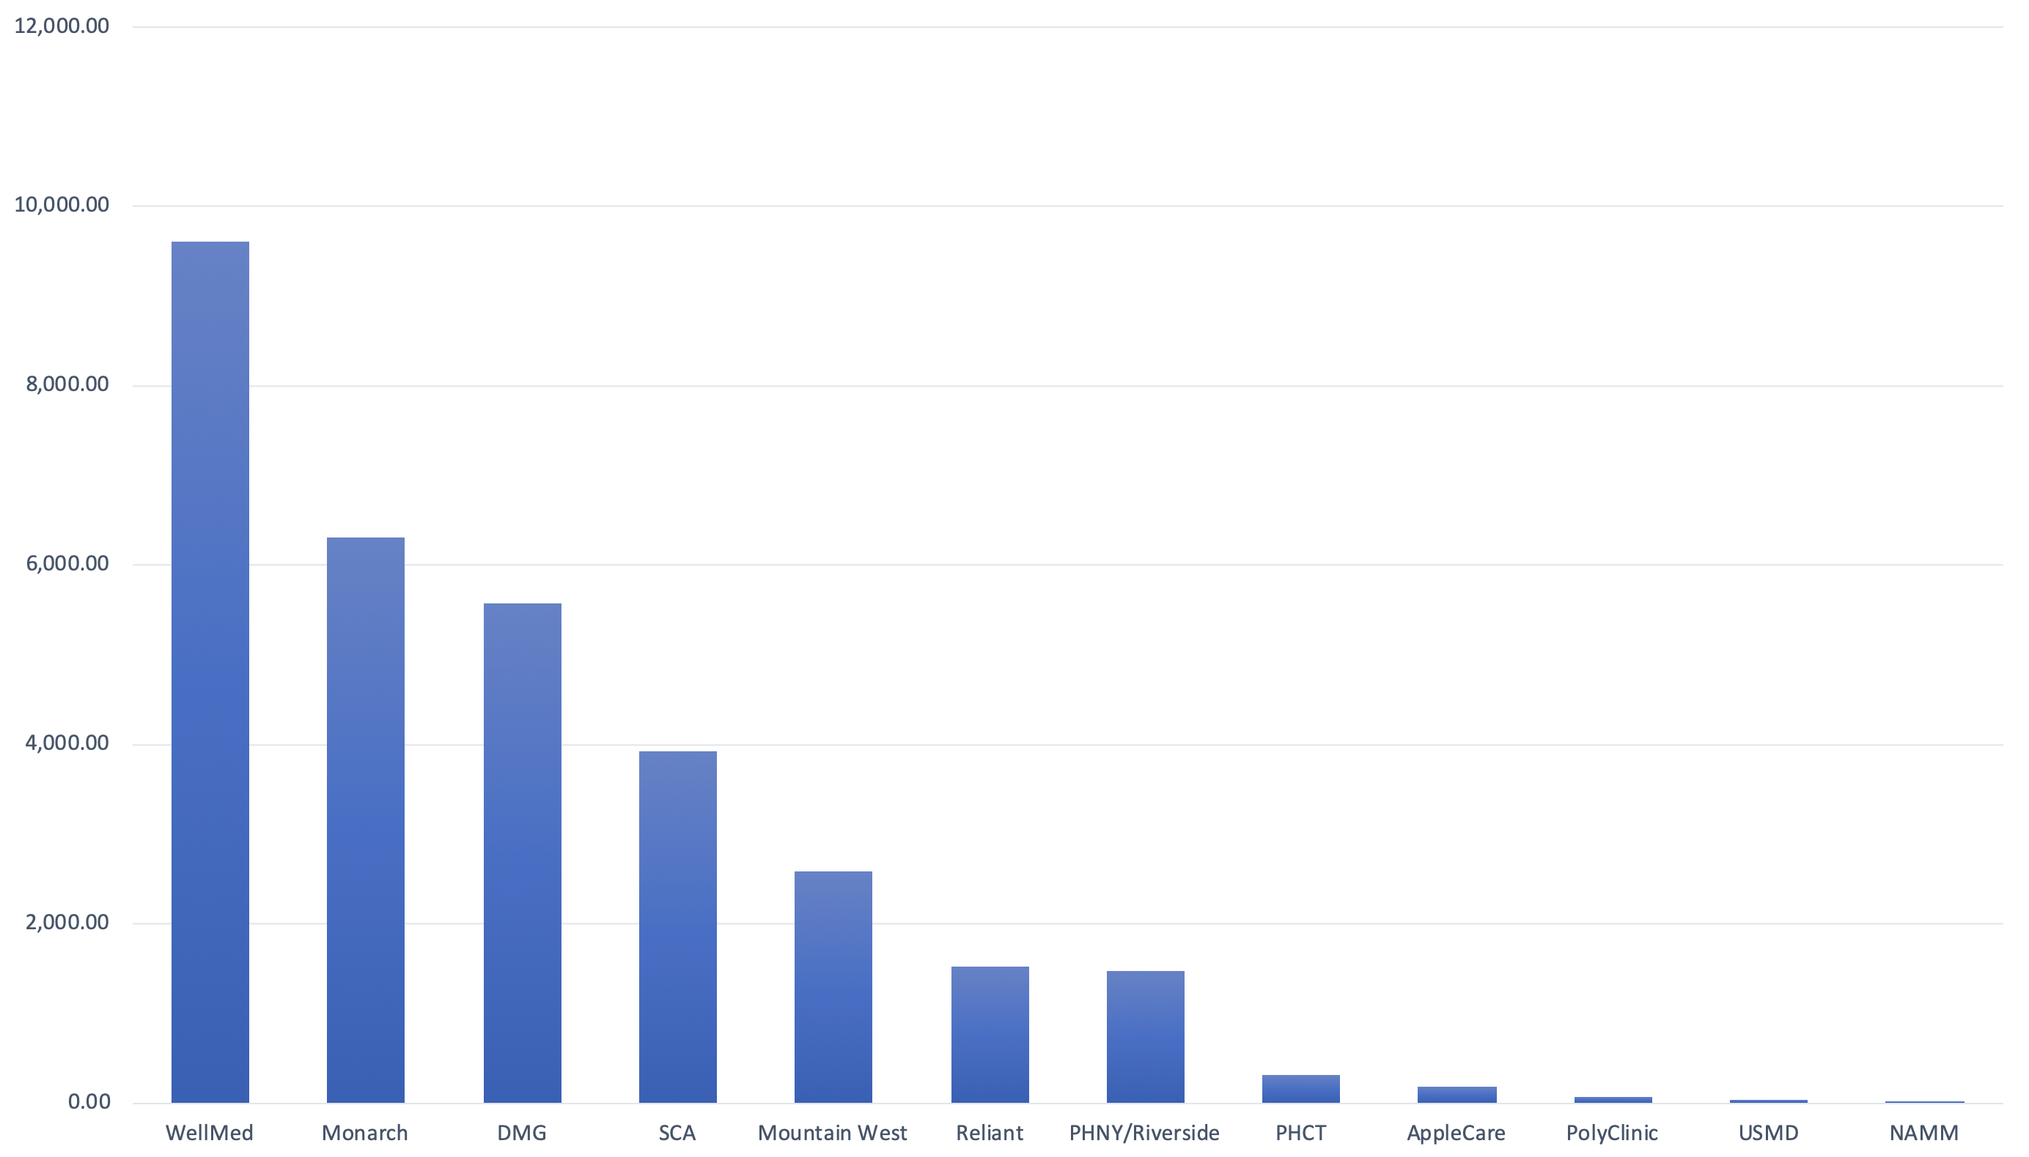
Physical CPU Provisioned and Average Utilization by CDO
9.6 THz
4.8%
6.3 THz
*
5.6 THz
4.3%
3.9 THz
3.6%
2.58 THz
2.4%
1.5 THz
1.48 THz
2.2%
3.1%
314 GHz
184 GHz
61 GHz
5.3%
4.3%
5.2%
42 GHz
22 GHz
Notes:
Black numbers above blue columns represent total PHYSICAL CPU provisioned
White numbers indicate average CPU utilization
*Not reporting

Slide 19
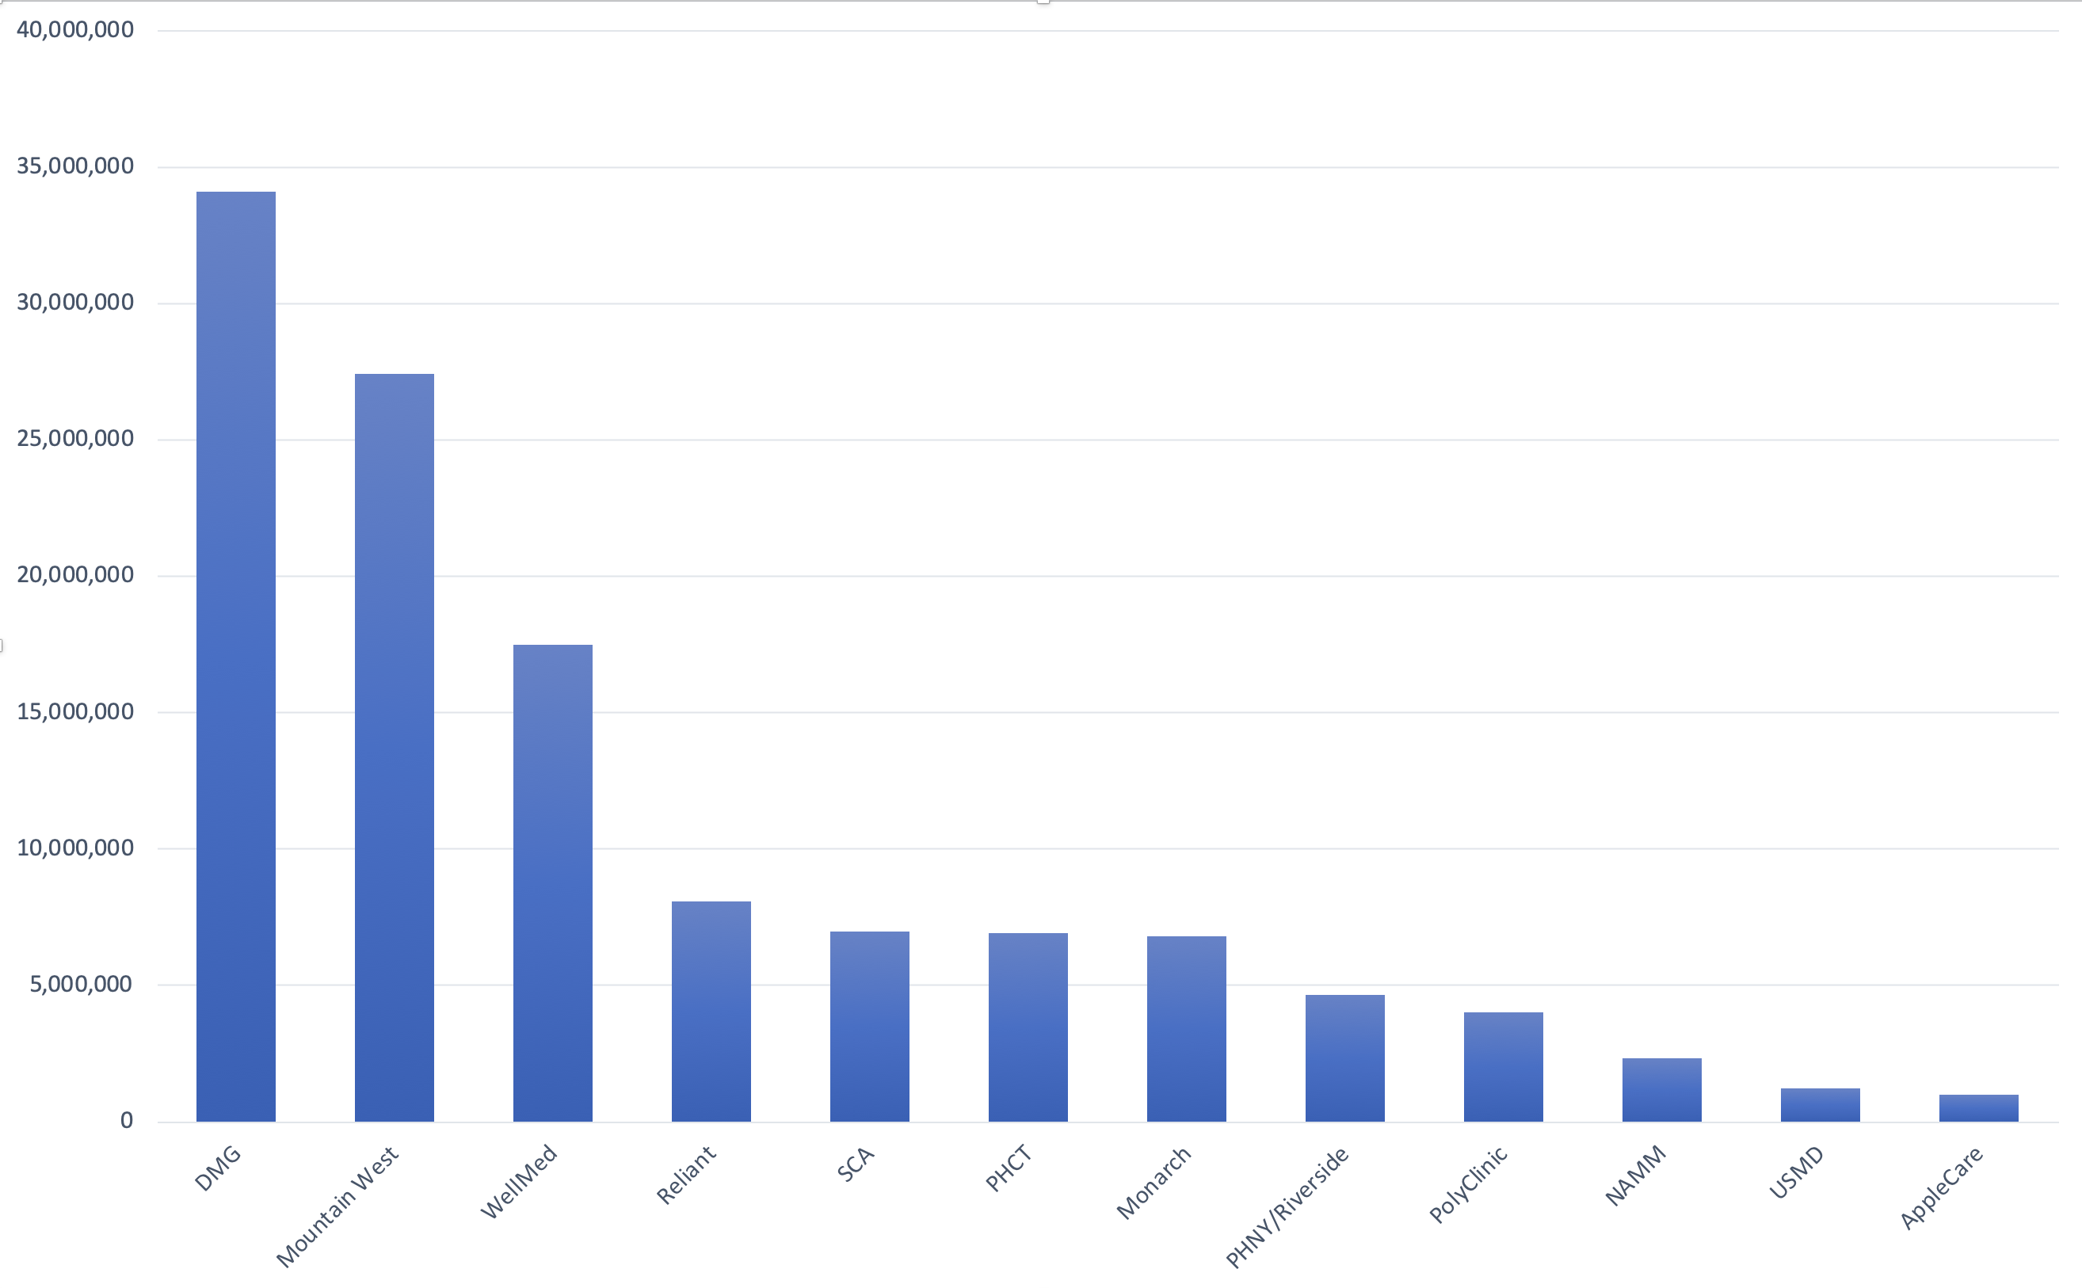
Virtual RAM Provisioned and Average Utilization by CDO
34 TB
32%
27 TB
31%
17 TB
35%
8 TB
7 TB
43%
6.9 TB
6.8 TB
40%
44%
35%
4.6 TB
4 TB
37%
53%
2.3 TB
44%
1.2 TB
1 TB
27%
40%
Notes:
Black numbers above blue columns represent total VIRTUAL RAM provisioned
White numbers indicate average RAM utilization

Slide 20
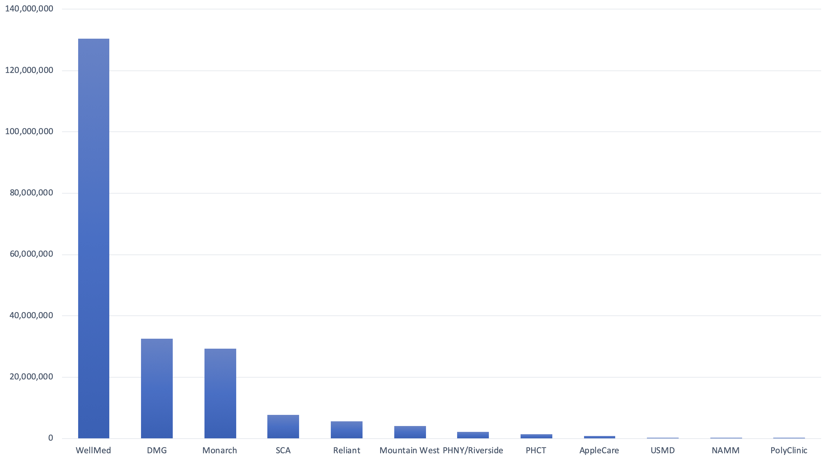
Physical RAM Provisioned and Average Utilization by CDO
130 TB
10%
33 TB
29 TB
36%
*
8 TB
6 TB
4 TB
31%
25%
2 TB
1.4 TB
842 GB
40%
36%
32%
32%
*
*
*
Notes:
Black numbers above blue columns represent total PHYSICAL RAM provisioned
White numbers indicate average RAM utilization
* Negligible or not reporting

Slide 21
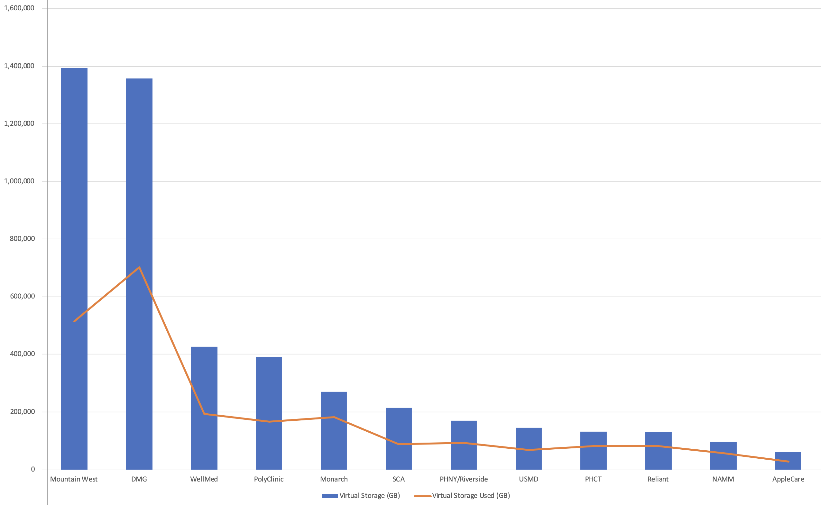
Virtual Storage Provisioned and Usage by CDO
37%
52%
46%
42%
67%
42%
55%
47%
61%
63%
59%
47%
Notes:
Percentages above each blue column represent percent used

Slide 22
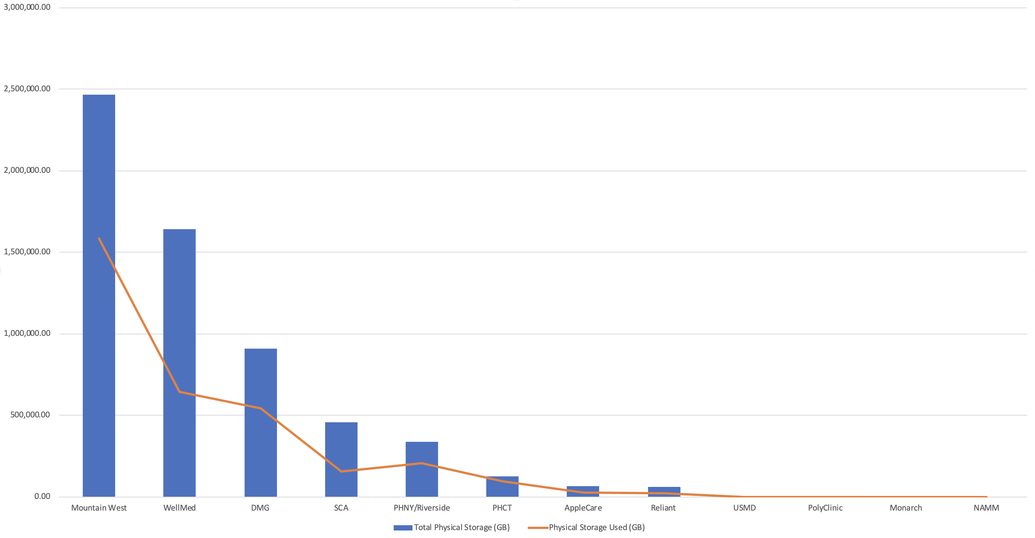
Physical Storage Provisioned and Usage by CDO
64%
39%
60%
34%
62%
77%
37%
39%
35%
42%
*
*
Notes:
Percentages above each blue column represent percent used
*Storage not reporting

Slide 23
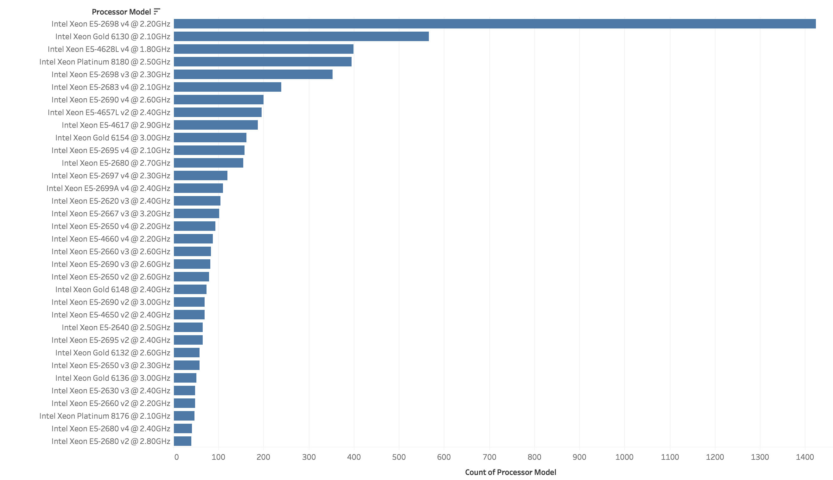
Top Processor Models

Slide 24
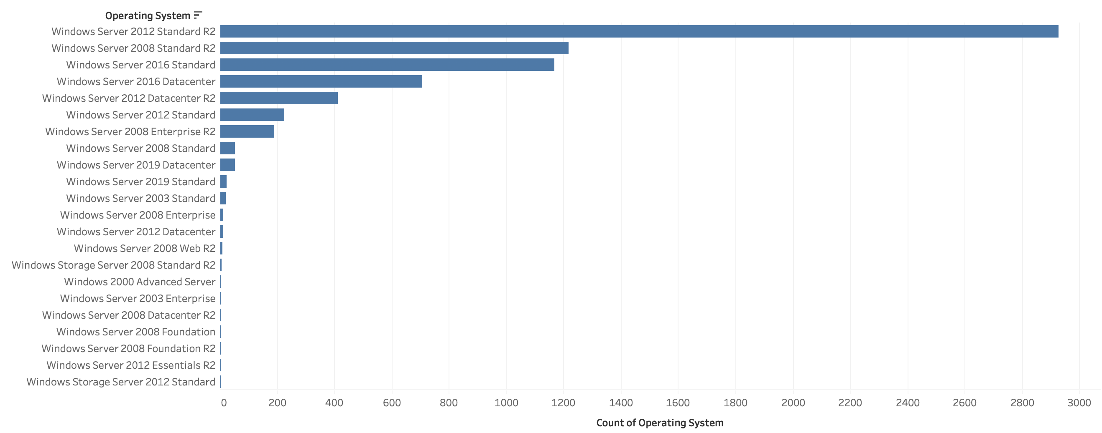
Virtual Operating System Count

Slide 25
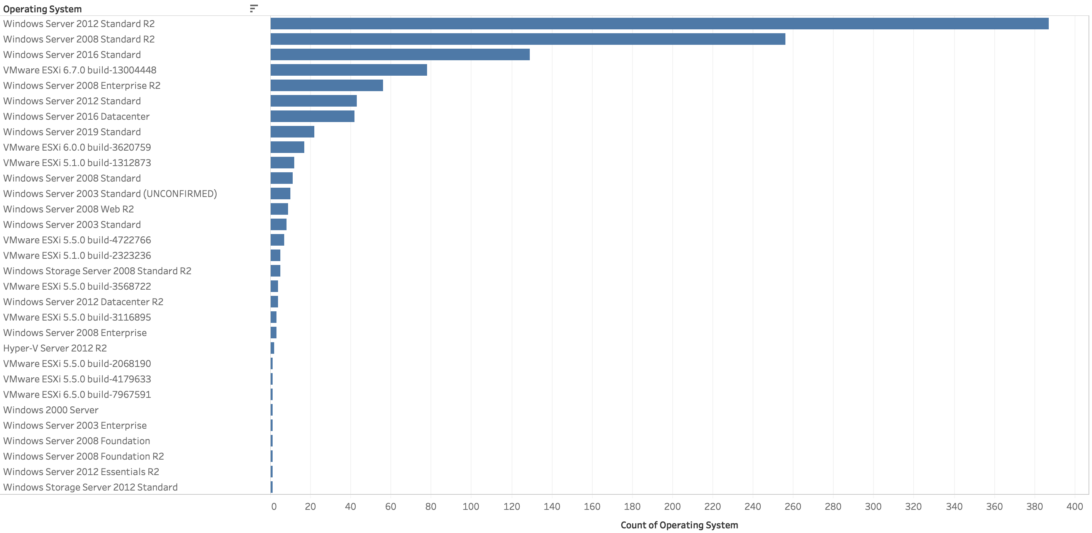
Physical Operating System Count

Slide 26
Key Takeaways
© 2019 Optum, Inc. All rights reserved. Confidential property of Optum. Do not distribute or reproduce without express permission from Optum.

Slide 27
Appendix
Supporting Files and
Additional Information

Slide 28
Supporting Files
Movere Tracking Spreadsheet
Tableau Workbook
Movere data extracts

Slide 29
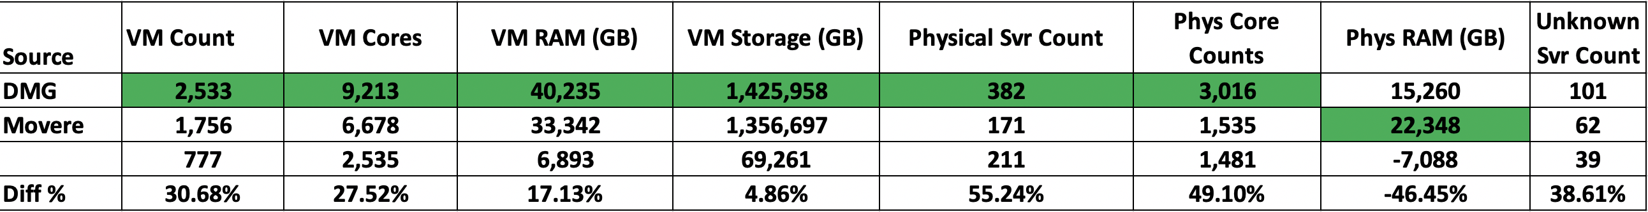
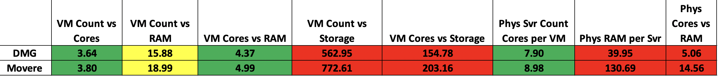
Margin of Error Example
In this example for DMG, Movere shows higher counts for Physical RAM but lower counts in every other category.
A comparison of ratios shows some similarities, but the per VM storage and physical RAM ratios are not relative.
Conclusion: Movere is a useful tool but does not capture all environment information accurately. This could be due to analysis exclusions during Movere installation, configuration problems, or other scanning anomalies. More internal data collection is needed to get a complete picture.

Slide 30
Storage Data Collection Layers
RESILIENCE
FAILOVER
REDUNDANCY
VIRTUAL LAYER
(iSCSI/FCoE/FC PROTOCOLS, DRIVE LETTER ASSIGNMENTS, etc.)
SERVER/HYPERVISOR LAYER
(iSCSI/FCoE/FC PROTOCOLS, DRIVE LETTER ASSIGNMENTS, PRESENTATION, etc.)
ABSTRACTION LAYER
(RAID LEVELS, LUNs, ACLs, PRESENTATION)
PHYSICAL LAYER
(RAW STORAGE, SAN FABRIC, STORAGE INFRASTRUCTURE, CABLES, etc.)

